Slide 1
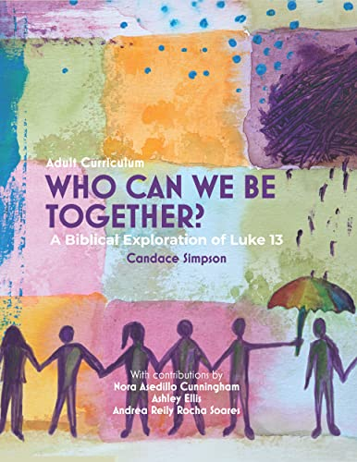
What does God say about creating space for care and safety?
About community building?
About shifting boundaries and norms?
And how can this be done when the entire world seems to be on fire?

Slide 2
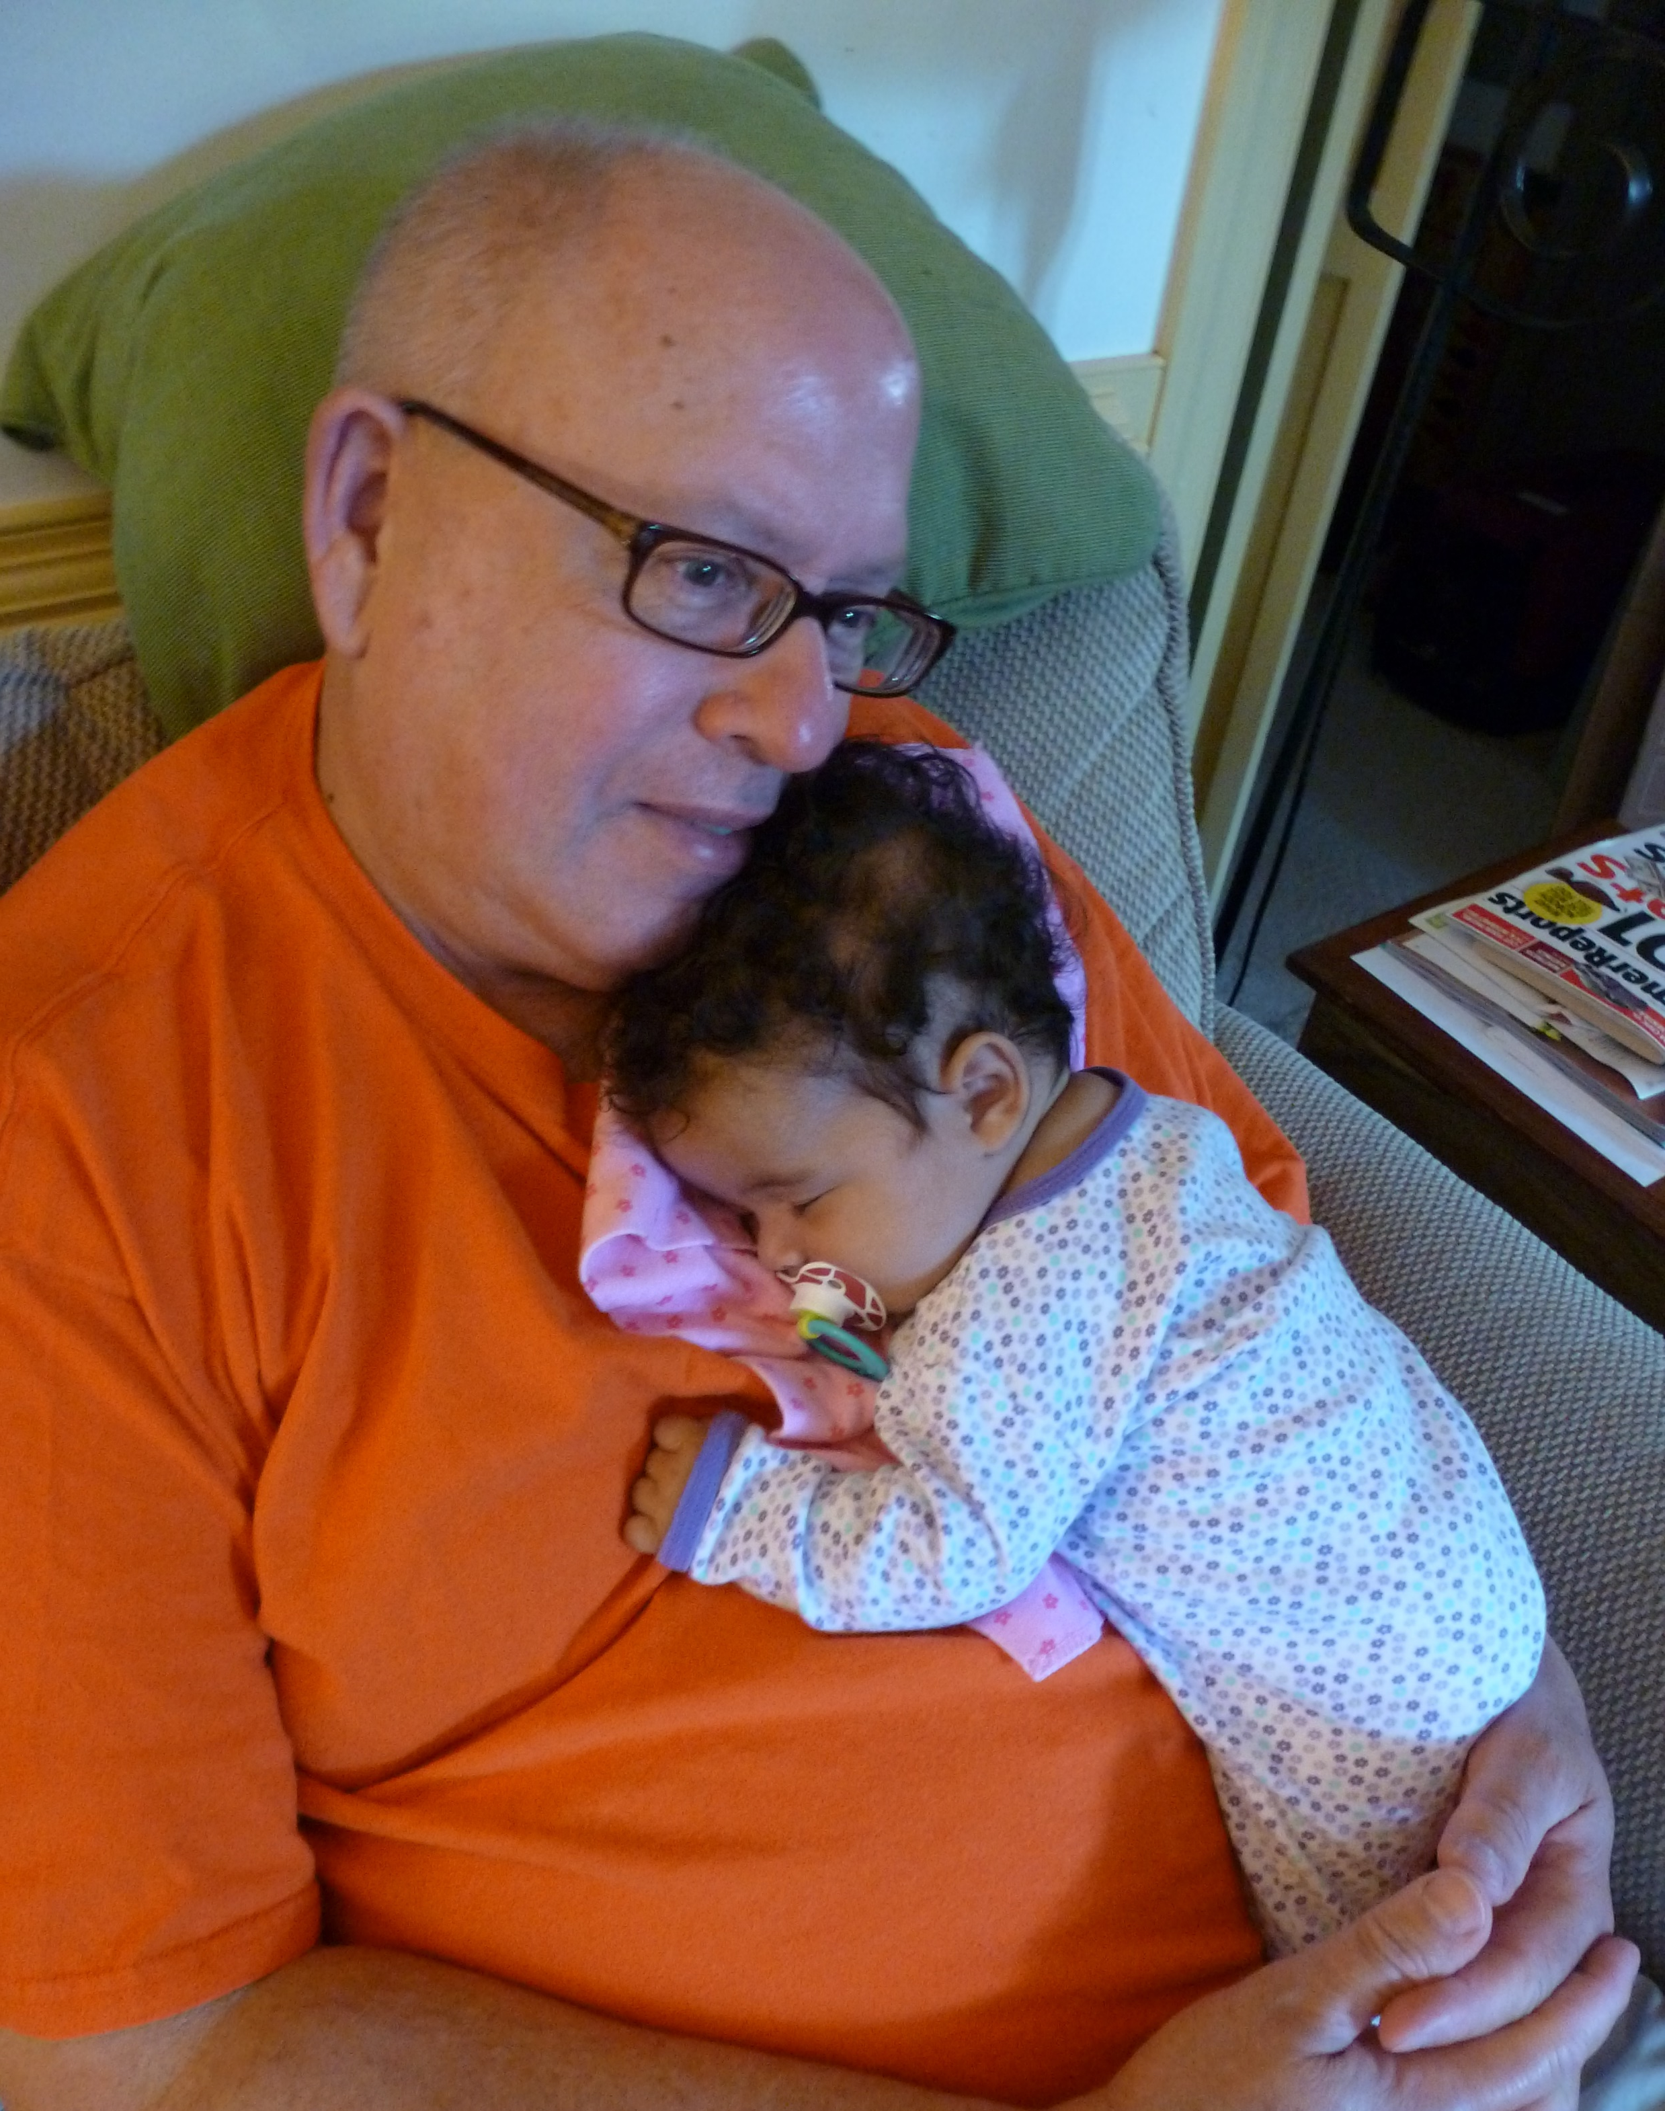
Welcome
Who has laid foundations for us, personally and communally?
How can we leave a more solid foundation for those coming after?
What does building a home require?

Slide 3
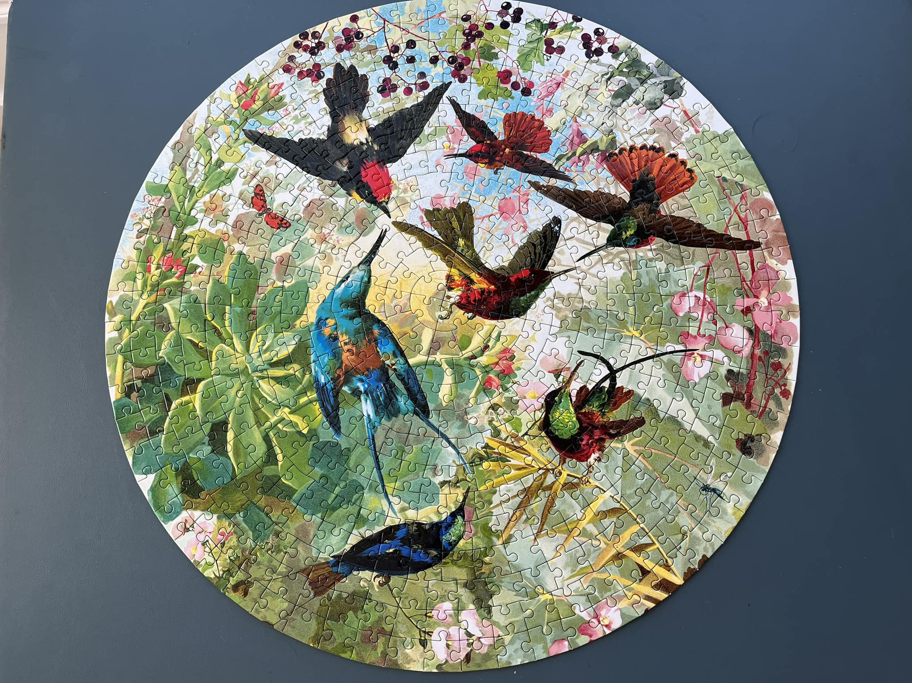
Jesus, in Luke 13 is frustrated , concerned – even snarky. His rage is aimed at the religious institutions of his day.
2000 years later we sit with the range of our own emotions in response to the words of Luke 13. Especially at the forces that drain us, exhaust us, and push us to act uncharacteristically
We are called to act on the principles of our faith and witness the ‘Kin-dom’ of God.
*Kin-dom, first coined by Ada Maria – Isasa Diaz, is used in place of the traditional “kingdom” to emphasize relationality; convey community, and equity as the basis of God’s reign.

Slide 4
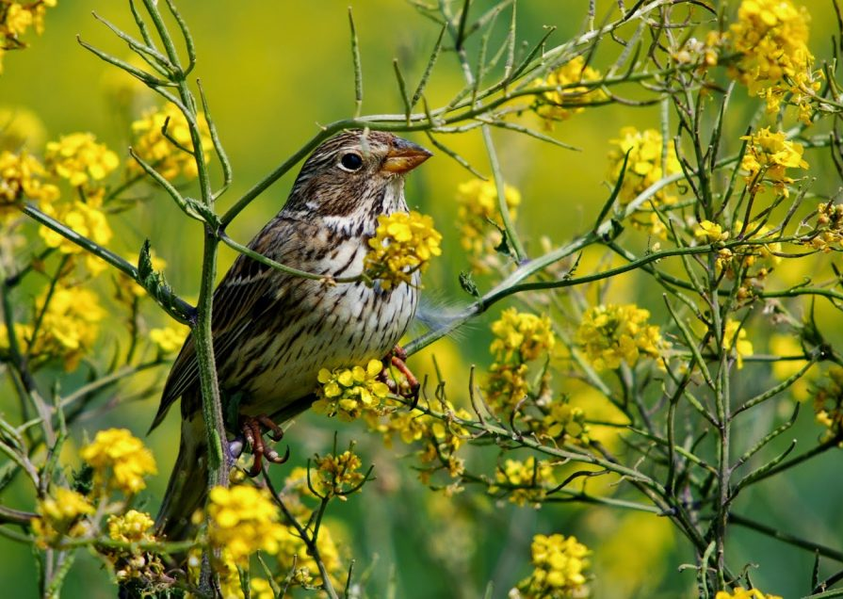
He said therefore, “What is the kingdom of God like? And what should I compare it? It is like a mustard seed that someone took and sowed in the garden; it grew and became a tree, and the birds of the air made nests in its’ branches. Luke 13, 18-19
This Photo by Unknown Author is licensed under CC BY-SA-NC

Slide 5
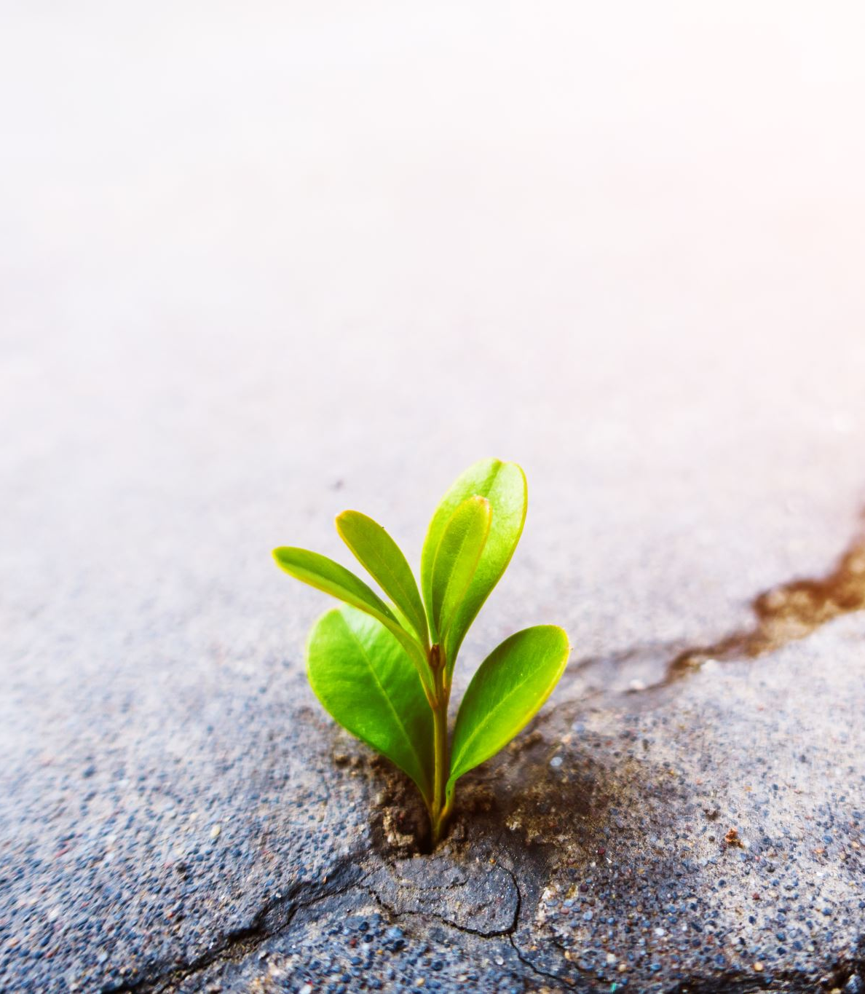
What is Jesus’ main point in this parable?
What does the seed do? Do you think the seed knows how it will eventually impact the ecosystem?
What kinds of seeds have you planted?
How do you see yourself at this stage of life? A seed? A tree? A bird?
Barriers? It helps just to know your community….letting go of expectations and preconceived ideas. How can I/we help?

Slide 6
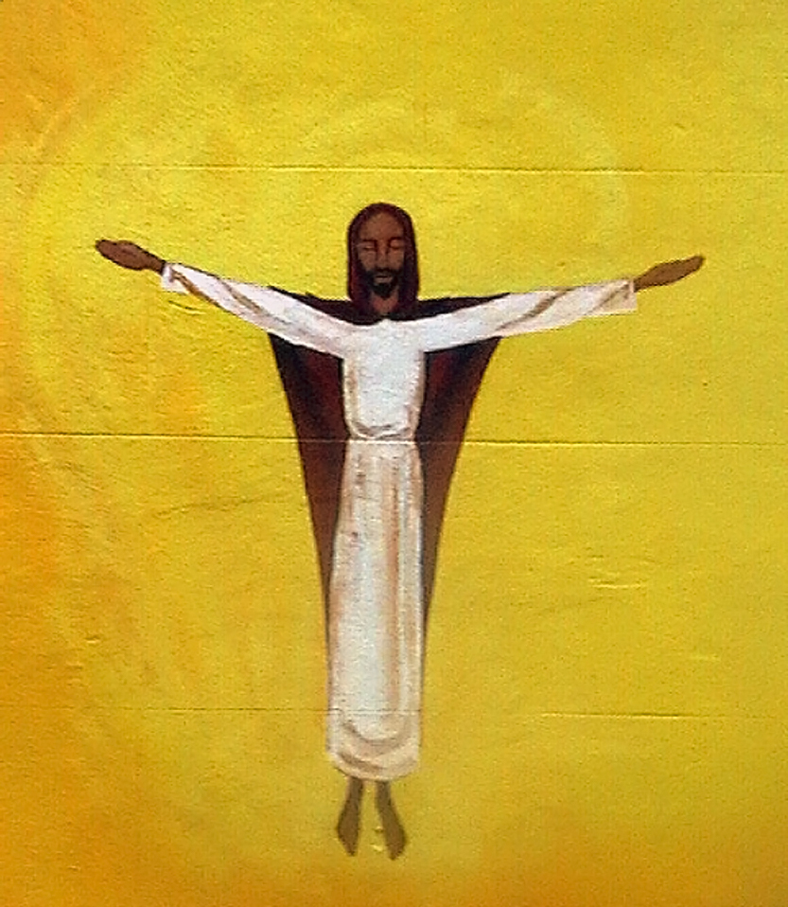
Who is in your pod….
randomly name what comes to mind……

Slide 7
What is one thing you want to remember from this parable……hold the mustard seed in your hand as we share together…
…what feels worthwhile and relevant….people are drawn to this kind of learning together.
…have thine own way, Lord….

Slide 9
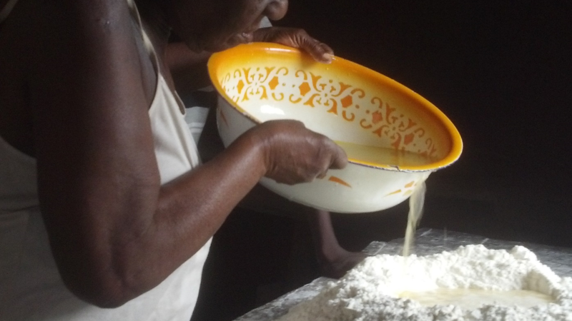
And again, he said, “To what should I compare the kingdom of God? It is like yeast that a woman took and mixed in with three measures of flour until all of it was leavened.”
Luke 13:20-21

Slide 10
What is yeast – ask someone explain to the group what yeast is and how it works.
Take a moment to reflect on the following questions
Who am I?
Who are my people?
What do I want?
What do I need to do/build to reach that?
Imagine together in small groups

Slide 11
Virginia Hamilton, in Her Stories, African American Folktales, Fairy Tales and True Tales – shares that the heart of the stories captures the heart of parables. The black slave woman was the keeper of households and at ‘dayclean’ she shared the tales she lived and imagined with those in her care. Little nuggets of wisdom, with potential to travel.

Slide 12
https://yutu.be/EXQoiTx0o-Q

Slide 13
Who can we be together?
So, who is a part of this ZOOM – and in your “pod” that you may not have considered?
These – our church going forward, aware and made new, grounded in grace and care, person to person, growing together in all our diversity!

Slide 14
Closing Prayer
Lord, you hear the longing of the ones left out.
We come on our knees, face down, into grace,
Our loads lighten as we accompany each other into fullness of life, together. Thank you. Thank you for giving us breath and connection. Grant us courage to move into the future with grounded hope. You are hope and you are here, freeing us for love.
Jesus you are with us when “…………………….” Amen

Slide 15
